Slide 1

Inventory Management System (IMS)
Ayesha Raja

Slide 2
Introduction
Who am I? – Ayesha Raja
Approach to the Specification:
Created a Java based CLI Program in Eclipse
Object Oriented program
Multiple Classes for each component of the Program (User Accounts, Customers Profiles, Products, Item Inventory, Customer Orders)
Events are triggers using the CLI interface (instantiating and object of the required class depending upon the required action)
Followed a Project Management Plan
Ensured Versioning Control using GitHub

Slide 3
Consultant Journey
Technologies I have learnt for this project include:
- Maven
- GitHub
SQL Workbench

Slide 4
CI
Version Control Management:
GitHub
Multiple Branches
Main Branch – The final product (merged branches)
Dev Branch – Includes multiple commits of software throughout development
SQL Branch – Added the Database SQL File and ERD
Testing Branch – To include the testing (Junit)

Slide 5
Demonstration
Administrator Stories
Create a new User
Add new products (Soaps)
Create Items -> Create Item from the previously created product
User Stories:
Login as a user
Register as a customer -> User account registers a customer profile
Edit customer profile

Slide 6
Sprint Review
What was completed?
Object Oriented program
Multiple Classes for each component of the Program
User Accounts, Customers Profiles, Products, Item Inventory, Customer Orders
What was left behind?
Testing
Jira
Verification of users

Slide 7
Sprint Retrospective
What went well?
UML
Java
GitHub
What could be improved?
Asking for help when needed
Knowledge on testing / Jira
Time management skills

Slide 8
Conclusion

Slide 9
Questions?

Slide 10
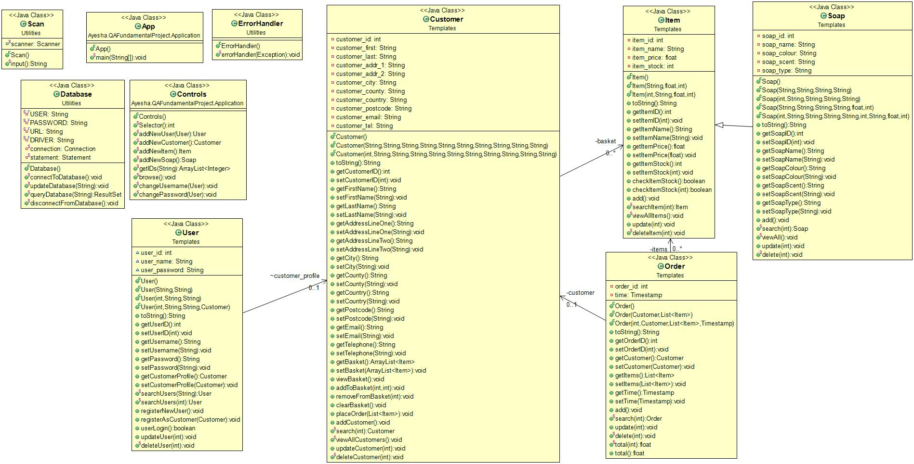
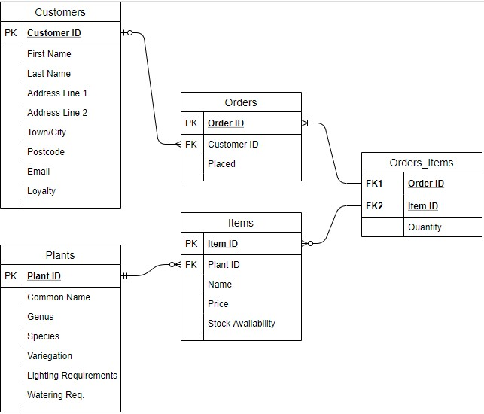
Diagrams

Slide 11
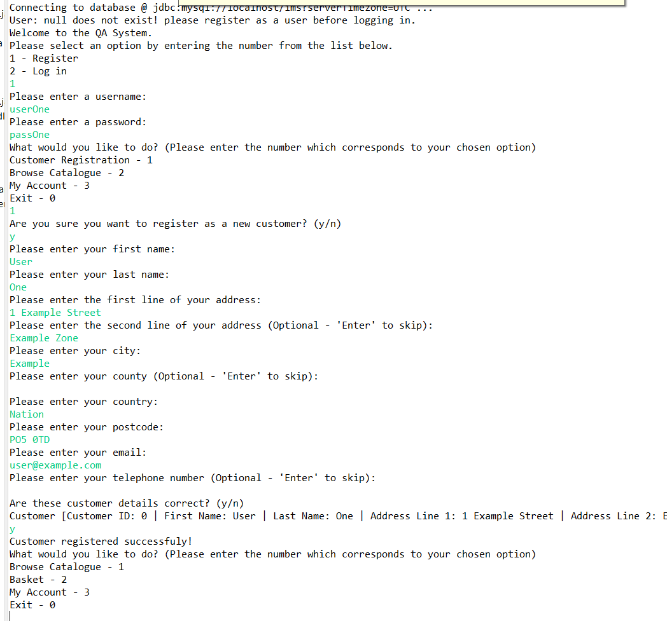
Screenshots
An example of a user registering an
Account. Then creating a user profile.

